Slide 1


ACA Project 1: Designing a Cloud Solution A Medical Company Startup This project is for a Medical Company who are wishing to move onto AWS.
Group Name: Mariah Carey Class: SD4
Member 1: Sean Daly (K00228585) Member 2: Christie Molloy (K00227958) Member 3: Alexander Ryan (K00209829)

Slide 2
Topics
Following information includes:
Configuring access permissions to conform to AWS best practices.
Network design features that conform to AWS best practices
Architecture alignment with and deviations from the current server hosting company.
Architecture's ability to accommodate future growth
Securing all sensitive information.
Utilizing load balancers for web tier and application tier that support HTTP, HTTPS, TCP protocols.
Architecture resiliency features.
Configuring auditing to track all user actions

Slide 3
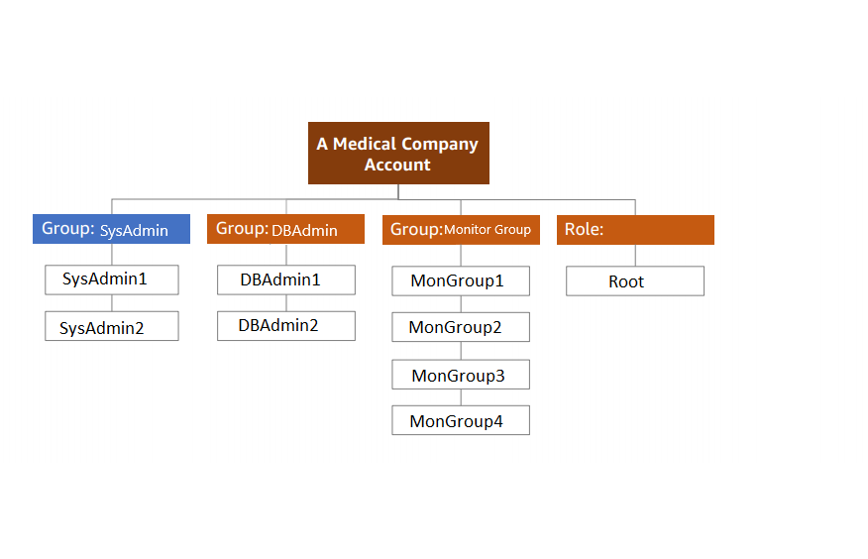
Configuring access permissions to conform to AWS best practices.

Slide 4
Groups and their associated permissions.
Group/Role # | Group/Role Name | Permissions
Group | System Administrator | aws:policy/AdministratorAccess
Group | Database Administrator | aws:policy/DatabaseAccess
Group | Monitoring Group | Monitors 4 users
Role | Root | Elevated Permissions0

Slide 5
User Authentication.
Requirements.
Requirement | Solution
Should be at least 8 characters and have 1 uppercase, 1 lowercase, 1 special character, and a number. | Set password policy on AWS for IAM users.
Change Passwords every 90 days and ensure that the previous three passwords can’t be re-used. | Require IAM users to change their password after a specified period of time (enable password expiration). Prevent IAM users from reusing previous passwords.
All administrators require programmatic access | Add permission policy for admin user group for programmatic access.
Administrator sign-in to the AWS Management Console requires the use of Virtual MFA. | Choose the Security credentials tab. Next to Assigned MFA device, choose Manage. In the Manage MFA Device wizard, choose Virtual MFA device, and then choose Continue.

Slide 6
Network and Security
VPC solution.
VPC | Region | Purpose | Subnets | AZs | CIDR Range
1 | EUwest-1 | Dev/Test | 6 | 2 | 10.0.0.0/12
2 | EUwest-1 | Production | 6 | 2 | 10.0.0.0/12

Slide 7
DEV/Test subnet solution
Subnet Name | VPC | Subnet Type (Public/private) | AZ | Subnet Address
Web-PublicSubnet1 | #1 | Public | A | 192.168.10.2
Web-PublicSubnet2 | #1 | Public | B | 192.168.10.2
App-PrivateSubnet1 | #1 | Private | A | 192.168.10.2
App-PrivateSubnet2 | #1 | Private | B | 192.168.10.3
DB-PrivateSubnet1 | #1 | Private | A | 192.168.10.4

Slide 8
Production subnet solution.
Subnet Name | VPC | Subnet Type (Public/private) | AZ | Subnet Address
Web-PublicSubnet1 | #2 | Public | A | 192.168.10.2
Web-PublicSubnet2 | #2 | Public | B | 192.168.10.2
App-PrivateSubnet1 | #2 | Private | A | 192.168.10.2
App-PrivateSubnet2 | #2 | Private | B | 192.168.10.3
DB-PrivateSubnet1 | #2 | Private | A | 192.168.10.4

Slide 9
Web and Application Tier
The type, size, and justification for the instances you will use for each tier.
Tier | Tag | OS | Type | Size | Justification | # of Instances | User data?
Web | Key= NameValue= web-tier | Microsoft Windows Server 2016 Base | T2 | Medium | They meet the requirements of the current architecture | 2 | No
App | Key = NameValue = app-tier | Microsoft Windows Server 2016 Base | T3 | xLarge | They meet the requirements of the current architecture | 2 | No
DB | Key = NameValue = db-tier | Microsoft Windows Server 2016 Base w/SQL Server SE | DB.M5 | 2xlarge | They meet the requirements of the current architecture | 1 | Yes

Slide 10
The load balancer and instance security group details.
Load Balancer | Name* | External/Internal | Subnets | SG Name* | Rule | Source
For Web Tier | web-elb | External | Web-PublicSubnet1 | web-elb-sg | Https | 0.0.0.0/0
For App Tier | app-elb | Internal | App-PrivateSubnet1 | app-elb-sg | Http | web-elb
Instance Tier | SG Name* | Rule | Source
Web Tier | web-tier-sg | Http | ELB
App Tier | app-tier-sg | Http | Web Tier
Database Tier | db-tier-sg | Microsoft SQL Server SE | App Tier

Slide 11
Business Continuity
The automatic scaling launch configuration.
Tier | OS | Type | Size | Configuration Name | Role | Security Group
Web | Windows server 2016 base | T2 | Medium | WebTier | systemAdmin | System Administrator
App | Windows server 2016 base | T3 | XLarge | AppTier | systemAdmin | System Administrator

Slide 12
The automatic scaling groups.
Tier | Launch Configuration | Group Name | Group Size | VPC | Subnets | ELB | Tags
Web | WebTier | WebTier | 2 | EC2 | Web-PublicSubnet1 | web-elb | Key= NameValue= web-tier
App | AppTier | AppTier | 2 | EC2 | App-PrivateSubnet1 | app-elb | Key = NameValue = app-tier

Slide 13
Auditing
Administrators must be able to track every AWS service-related action in the account.
How can these requirements be satisfied using AWS?
We can use Amazon Cloud watch to set up monitoring on metrics we need to measure.
We can then use Simple notification Service to notify system administrators if values are out of pre-set ranges.

